Slide 1


Biosparkz
TITLE PAGE
Problem Statement Title-Smart Neonatal Monitoring-NeoGuard
Theme-Health & Well-being
Team Name-Biosparkz

Slide 2

Biosparkz
PROBLEM STATEMENT
1.Problem-Newborns, especially preterm or critically ill infants, require constant and accurate monitoring. Traditional systems are often bulky, invasive, and limited to hospital settings, which can delay early detection of health issues and increase the risk of complications.
2.User Painpoints-
Delayed Response: Lack of real-time, intelligent alerts can delay critical interventions.
Limited Mobility: Wired systems restrict baby movement and complicate caregiving.
3.Existing methods-
Conventional NICU Monitors: Accurate but invasive, bulky, and hospital-bound.
Wearable Baby Monitors (e.g., Owlet): Designed for home use, less clinical accuracy, and limited analytics.
2

Slide 3
.
Biosparkz
IDEA TITLE
Proposed Solution
The Smart Neonatal Monitoring System (SNMS) is an advanced solution designed to monitor the health of newborns in real-time,particularly in neonatal intensive care units (NICUs).
The system uses wearable sensors and a cloud-based platform to provide continuous,non-invasive, and reliable monitoring of vital signs, ensuring immediate intervention when abnormalities are detected.
This System offers round-the-clock monitoring of newborns, ensuring early identification of critical health issues and minimizing the risk of human error. It enhances NICU efficiency, allows remote parental monitoring, and integrates data into EHR for better decision-making and personalized care.
Novelty and Uniqueness-
Non-invasive, wireless sensors for baby comfort and mobility.
Real-time remote monitoring via mobile/web apps for doctors & parents.
Cloud-based data storage with smart analytics and long-term tracking

Slide 4
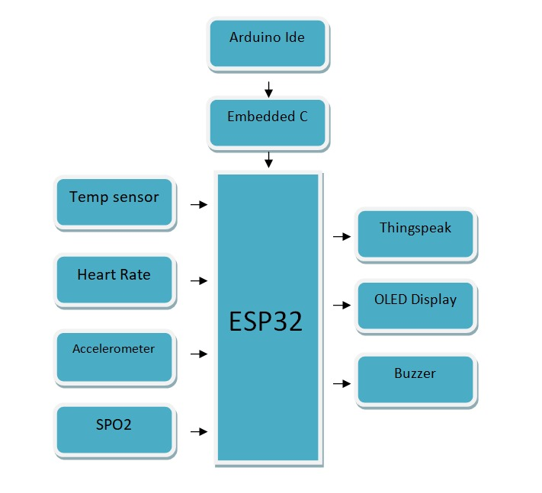
Biosparkz
TECHNICAL APPROACH

Slide 5
Biosparkz
FEASIBILITY AND VIABILITY
This System is technically feasible with growing market demand, but faces challenges in high development costs, regulatory approval, and market adoption. Overcoming these through strategic partnerships, phased development, and secure data handling will be key to success.
Potential challenges include high development costs, regulatory hurdles, and resistance to adopting new technology in healthcare settings. Additionally, ensuring sensor accuracy, data security, and seamless integration with existing hospital systems are critical risks that need to be addressed.
To overcome these challenges, collaborate with medical experts, ensure rigorous testing, and secure
regulatory certifications early. Implement phased development, offer pilot programs for adoption,
and use strong encryption for data security to build trust with healthcare providers.

Slide 6
Biosparkz
IMPACTS AND BENEFITS
➢ A Smart Neonatal Monitoring System offers significant benefits across social, economic, environmental, and healthcare domains.
➢ Socially, it improves newborn survival rates and provides peace of mind to parents through real-time monitoring and alerts, while also enabling remote care access in underserved areas.
➢ Economically, it helps reduce hospital stays and treatment costs by allowing early detection of health issues and efficient use of medical staff and resources.
➢ Environmentally, it promotes paperless data management, energy-efficient devices, and reduces the need for frequent hospital visits, lowering carbon emissions.
➢ From a healthcare perspective, it enhances patient safety through continuous monitoring, minimizes human error, and supports early intervention and data-driven medical decisions.

Slide 7
Biosparkz
RESEARCH AND REFERENCES
De D, Mukherjee A, Sau A, Bhakta I. Design of smart neonatal health monitoring system using SMCC. Healthcare technology letters.2017 Feb;4(1):13-9.
The system integrates temperature, acceleration, and heart rate sensors to monitor neonates, with data stored in the cloud for real-time access by healthcare providers.
2. Cay, Gozde, et al. (2021) – "An IoT-based Neonatal Monitoring System Integrated with Smart Textiles“
This study introduces a wearable smart textile system embedded with sensors for real-time neonatal vital sign monitoring. It uses IoT to transmit data to healthcare providers, enhancing monitoring accuracy and neonatal care.
3. Suresh L. et al. (2014) – "Neonatal Monitoring System“
The paper presents a basic neonatal monitoring system that tracks key vitals such as temperature and heart rate. It emphasizes low-cost implementation using embedded systems for use in rural or resource-limited settings.

Slide 8
Biosparkz
TEAM MEMBERS DETAILS
Team Leader :Lavanya A/Biomedical/III
Team Member 1 :Mathumitha G/Biomedical/III
Team Member 2 :Ritthi T/Biomedical/III
Team Member 3 :Gunavathi M/Biomedical/III

